Slide 1
Machine learning
Introduction to Machine Learning
Vincent Vankrunkelsven

Slide 2
Content
What is Machine Learning?
Performance Measures
Classification
Regression
Clustering

Slide 3
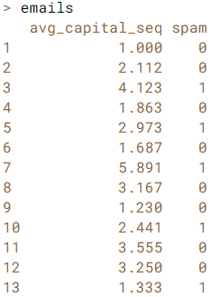
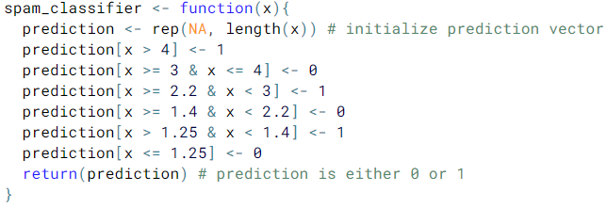

Classification
Classification attempts to assign a class (binary or multiclass) to a new observation given a vector of features (numerical or categorical)
Applied R (Classification: Filter Spam)
In this example the training data (emails) is used to develop the Classifier. However this is not a valid approach in an actual classification MLP.
Classifier
feature vector
label on observed data
Class predictions from our Classifier

